Slide 2
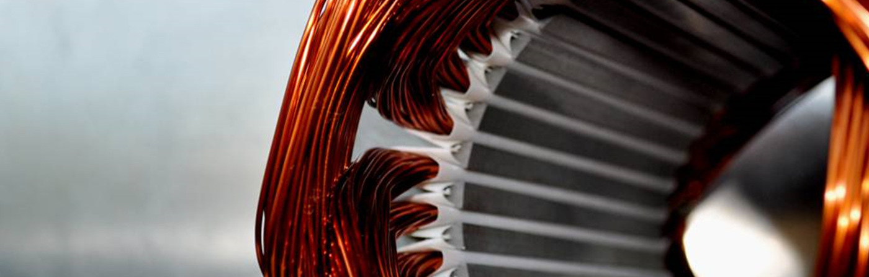
Development of A Parametric Tool for Automated Slot Insulation Insertion in Small-Scale Electric- Motor Stator Production
Alen Sebastian 23221507 (M Sc Electromobility)
Project Thesis Presentation

Slide 3
Table of Contents
Motivation and objectives
Fundamentals of Electric Motor Manufacture
Slot-Liner Function and Importance
Insertion of Slot Liners in Large Scale Manufacture
Insertion of Slot Liners in Small Scale manufacture
Proposed Automation Plan
Hardware Setup
Parametric Tool Development
Insertion Pipeline
Testing and Validation
Conclusion and Outlook

Slide 4
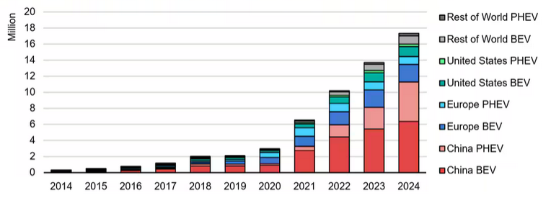
Motivation: Climate Change and Increase in demand for EVs.
Climate change & CO₂ emissions → need for sustainable technologies
Transport sector accounts for about 23% of global CO2 emissions
Electrification trend → rapid growth of EVs →surge in electric motor demand
Large-scale production: highly automated
Small-scale/custom production: still manual, especially slot liner insertion
Manual process = time-consuming, inconsistent, costly
Fig 1: Global EV sales [1]

Slide 5
Objective: To Develop a flexible insertion tool to automate slot-liner insertion in small-scale stator manufacturing
Automated Slot-Liner Insertion
Parametric Tool Design
Flexible manufacturing
Robotic Integration and validation
Process reliability and repeatability

Slide 6
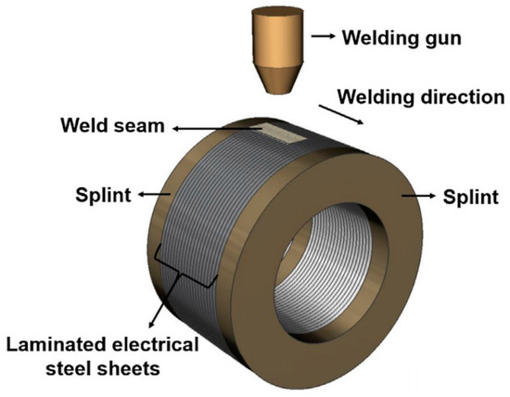
Key Steps Involved in the Manufacture of a Stator:
Core Preparation – Laminated electrical steel sheets are cut, stacked, and bonded to form the stator core.
Insulation Insertion – Slot liners and other insulation elements are placed to isolate windings from the core.
Winding & Interconnection – Copper wires are wound into slots and interconnected (crimping, soldering, welding).
Stabilization & Testing – Resin impregnation improves insulation and thermal performance, followed by electrical tests for quality assurance.
Fig 2: Lamination stacks forming the stator [2]

Slide 7
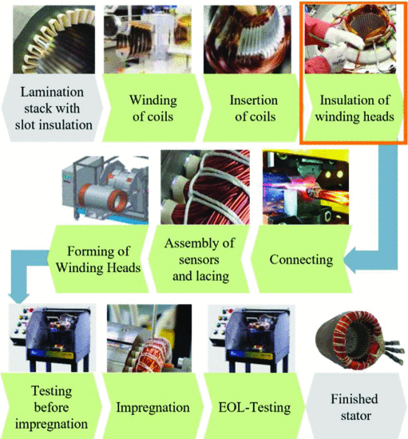
The Entire Stator Assembly Process from Insulation to Winding:
Fig 3: Entire Stator assembly process [3]

Slide 8
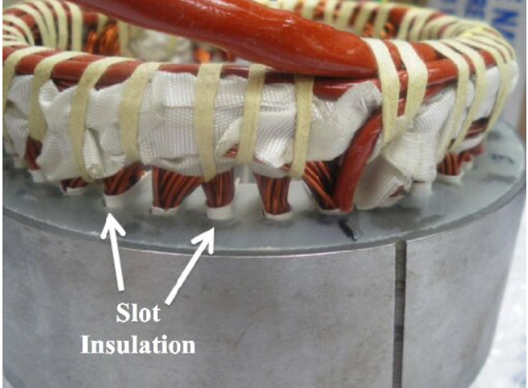
Why Slot liners are Important in Stator Manufacture:
Electrical Insulation
Thermal Management
Wear Resistance
Winding Retention
Fig 4: Slot Liner Function [4]

Slide 9
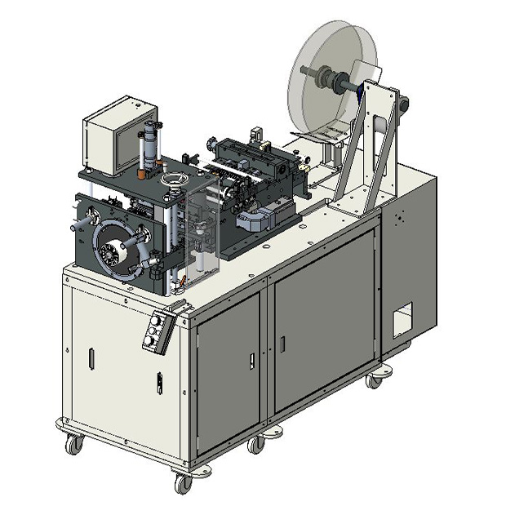
How slot liners are inserted in large scale manufacture such as in the automotive industry:
Large batch manufacture with constant motor size.
High Investment costs.
High speed insertion (3 sleeves per second).
Not suitable for high variance, low volume production.
Integrated cutting, folding and creasing.

Slide 10
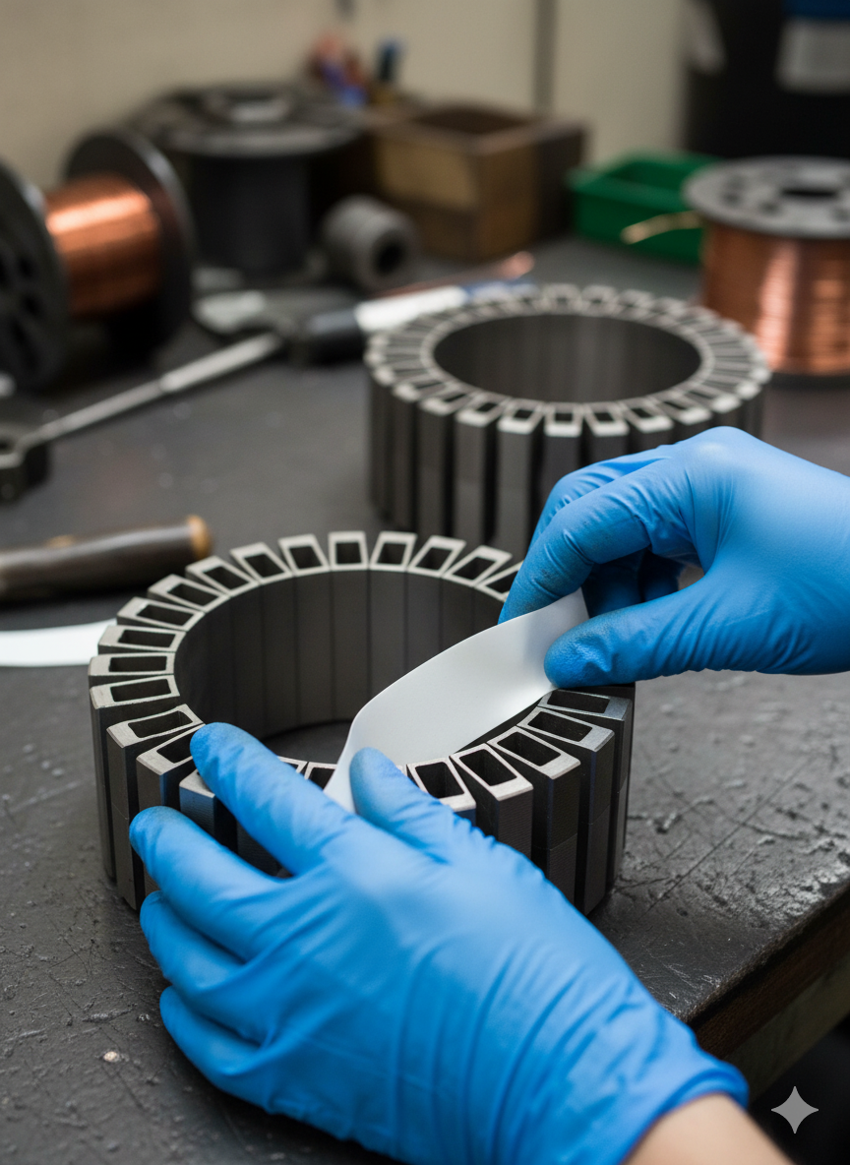
How slot liners are inserted in small scale manufacture such as in aviation or naval industries:
High variance low volume production.
Flexible, low cost.
Insertion is done manually.
Labor intensive, difficult to scale.
Use of jigs, cutting/folding machines.

Slide 11
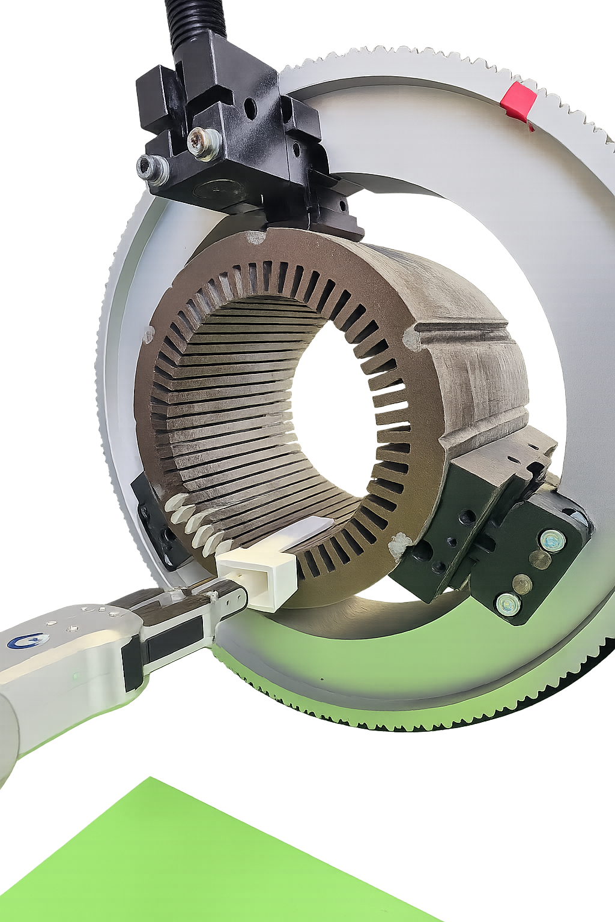
Proposed Automation Plan
Goal: Automate slot liner insertion for small-scale, high-variant motor production.
Approach:
Develop a parametric tool adaptable to different stator sizes and shapes.
Integrate with a collaborative robot setup (UR10e, gripper, FT sensor).
Workflow Concept:
Slot liner positioning
Orientation with funnel/clamp system
Automated insertion with robotic guidance
Expected Benefits:
Increased precision and repeatability
Reduced labor intensity and errors
Flexibility for small-batch, high-variance manufacturing

Slide 12
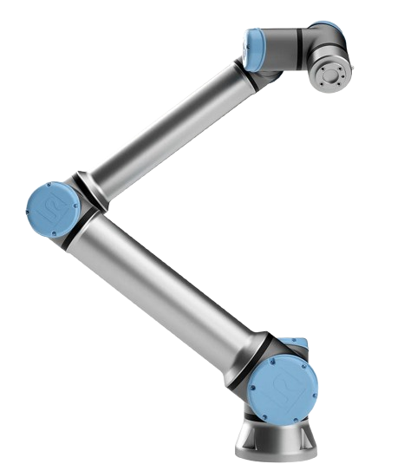
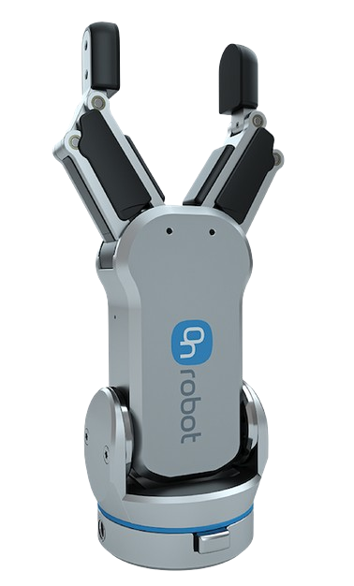
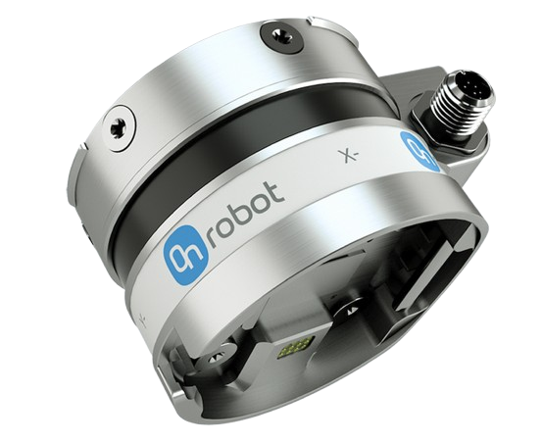
Robotic Module for Automated Insertion: UR10e Collaborative Robot, RG2 Gripper, and Force/Torque Sensor
UR10e Cobot:
Provides precise programmable motion 12.5 kg payload 1300 mm reach compact and safe Easily adaptable for flexible manufacturing
RG2 Gripper:
Adjustable 2 finger gripper 110 mm stroke length Intelligent grip detection Customizable fingertips Suitable for secure handling of Slot Liners
HEX Force-Torque Sensor:
Real-time force monitoring 6 axis Force Torque measurement Ensures accurate insertion of liner Misalignment detection Configurable force thresholds

Slide 13
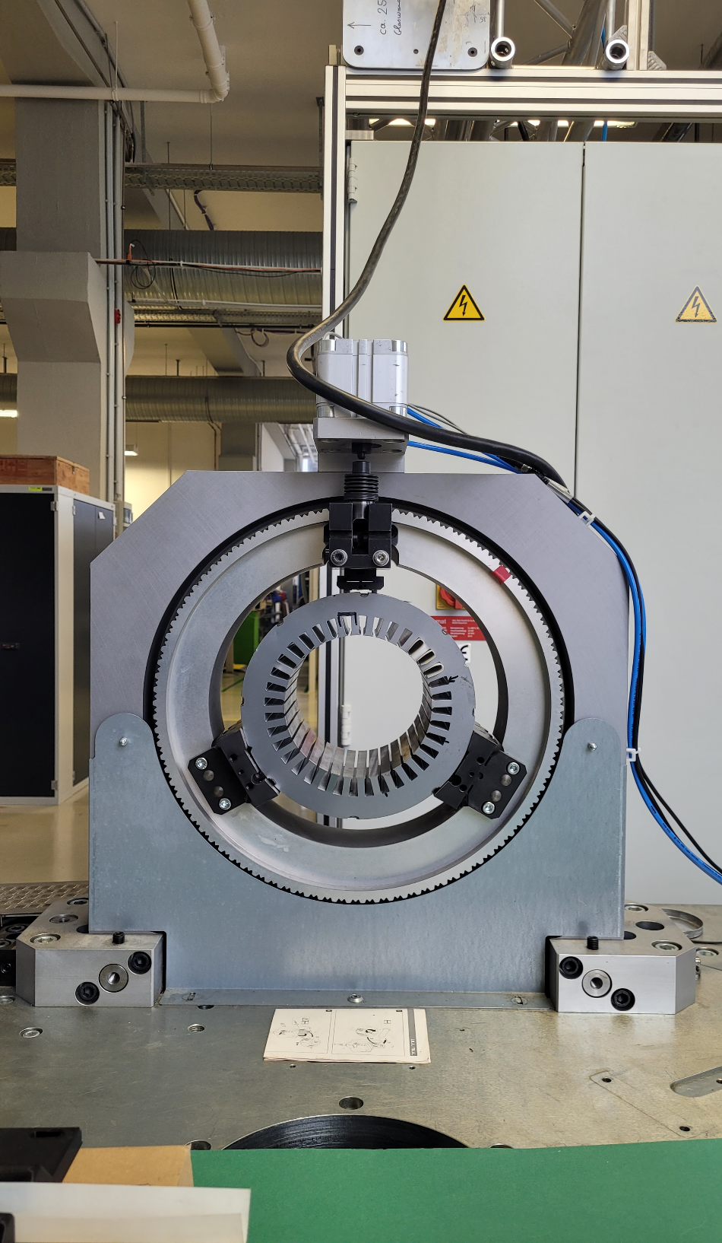
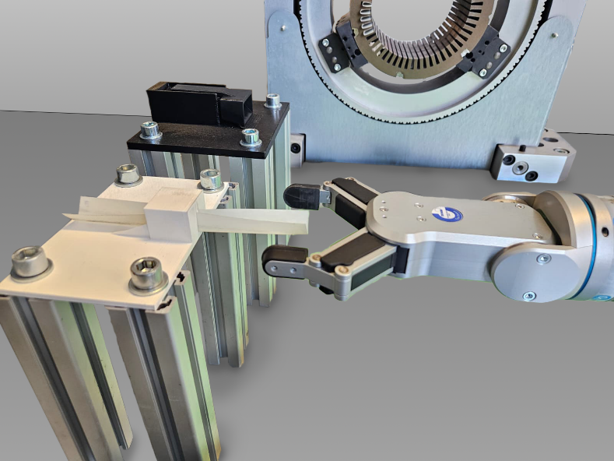
Mechanical Fixtures for Accurate Positioning of Stator, Slot Liner, and Funnel
Rotating Mechanical Clamp
1). User-defined rotation aligns each slot with the funnel for fully automatic insertions. 2). Servo Motor + Siemens S7-1500 PLC - Provides precise, deterministic low-level motion control. 3). Manual origin calibration, stop-rotation function for safety, collision avoidance, and adaptability
Rotating Mechanical Clamp
Slot Liner and Funnel Positioning Platforms
1). Secure, repeatable positioning for insertion tool and slot liners 2). Quickly accommodates different stator or slot liner geometries with minimal downtime. 3). Ensures accurate robot grasping, reducing misalignment and improving repeatability. 4). Enhances workflow efficiency in small-batch or high-mix production while maintaining precision.

Slide 14
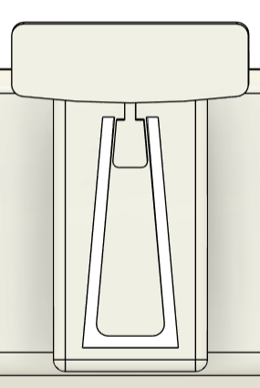
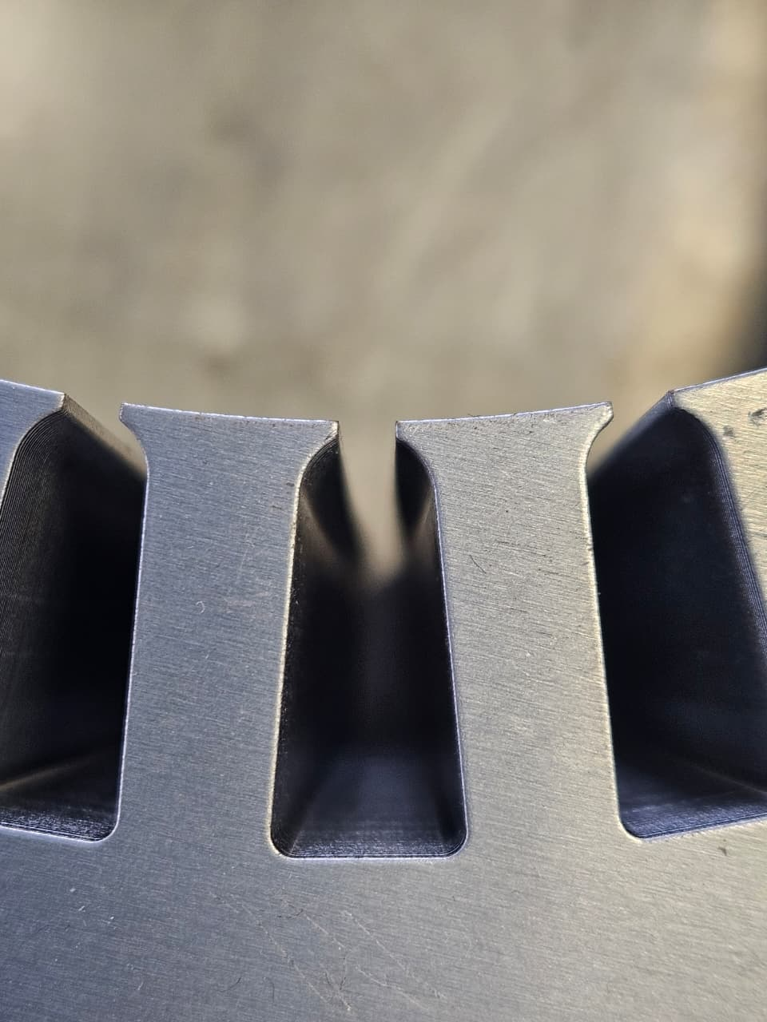
Parametric Tool Development
Slot Height
Slot Angle
Slot Width
a) Funnel parameters
b) Actual slot in a stator

Slide 15
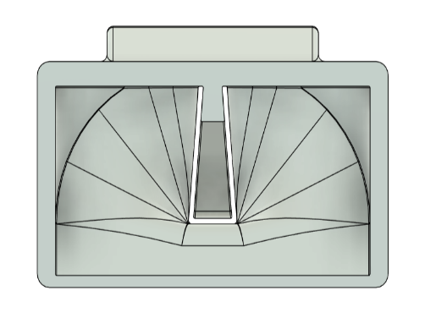
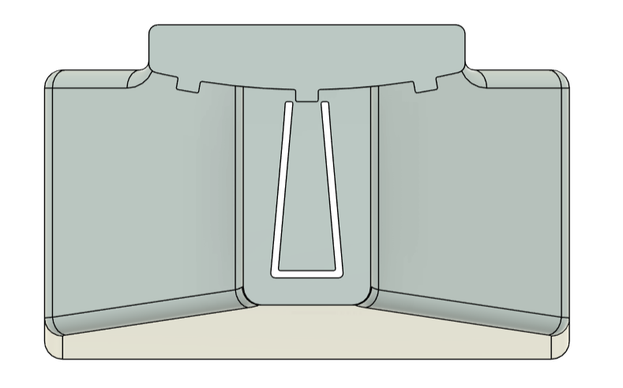
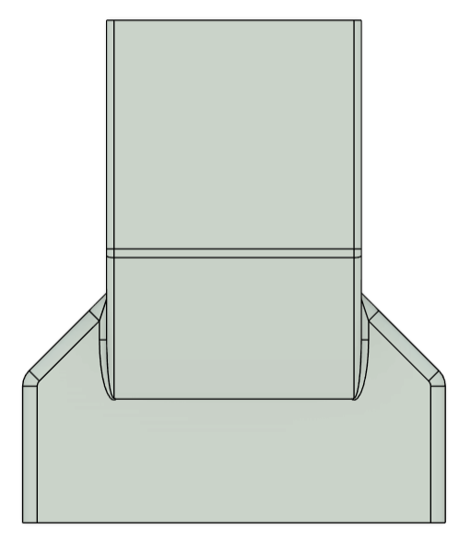
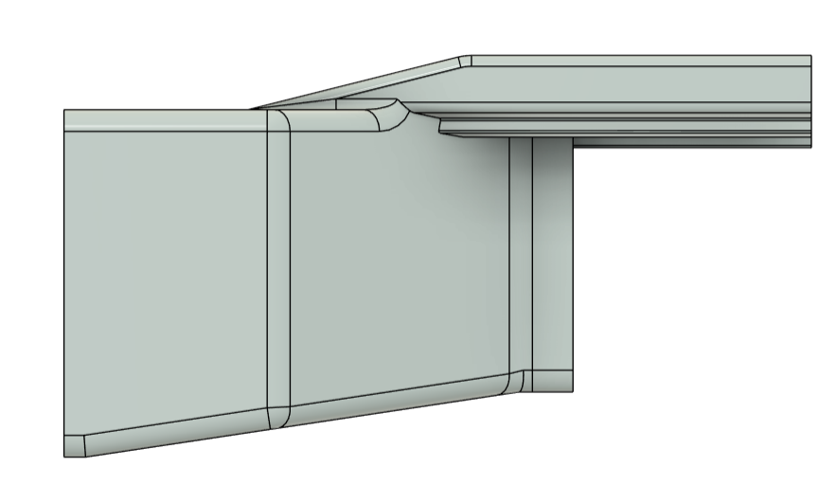
Initial Design
Parametric tool geometry easily adaptable for different slot sizes.
Flared, tapered internal channel, that guides the slot liner smoothly towards the stator slot.
a) Front view
b) Rear view
Inner and outer guide rails to maintain precise alignment with the stator slot.
c) Side view
Cheap and Easily prototyped. Material used - PLA
d) Top view

Slide 16

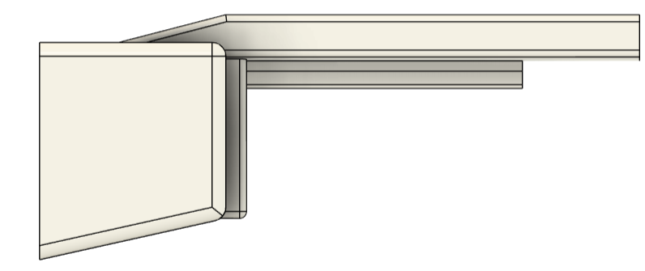
Observations and Limitations of the Initial prototype
Prototype Evaluation:
The initial prototype confirmed the feasibility of the parametric funnel concept but revealed key weaknesses
Three external guide rails made insertion process-sensitive and dependent on precise alignment.
Short tail section and wide inlet shifted the center of gravity forward, causing funnel instability
Complex geometry reduced adaptability across stator types
Findings guided redesign for improved tolerance, locking, and stability in automated use.
Initial Prototype
Final Prototype

Slide 17
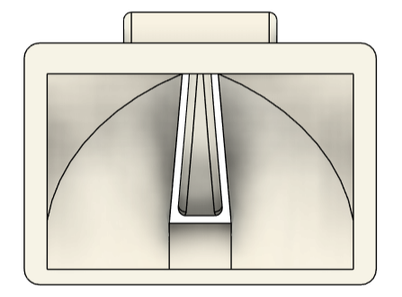
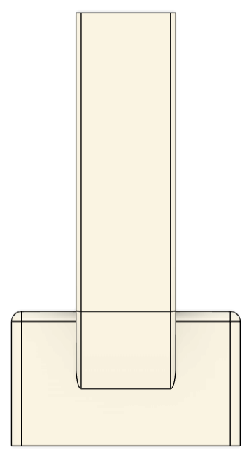
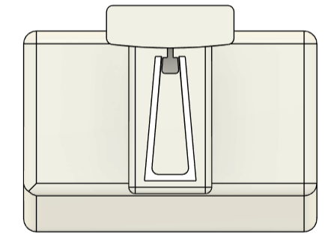
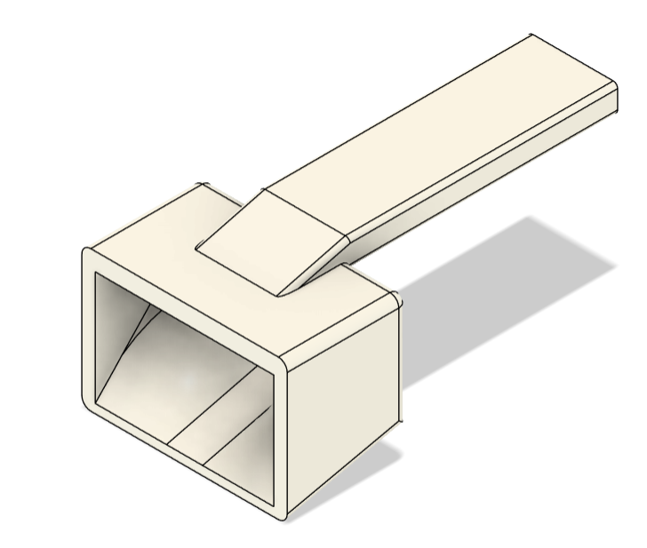
Final Design
Simplified guiding system: Replaced three rails with a single elongated rail featuring grooves for mechanical locking and easier insertion.
Improved stability: Extended and thickened tail (by 50 mm) to shift the center of gravity rearward and prevent forward tilting.
a) Front view
b) Rear view
c) Top view
Refined outlet geometry: Slightly undersized outlet (2–3%) ensures smooth liner entry without edge damage.
Enhanced adaptability: Simplified overall geometry for easier parametric adjustments and faster design modifications.
d) Side view
e) Isometric view

Slide 18
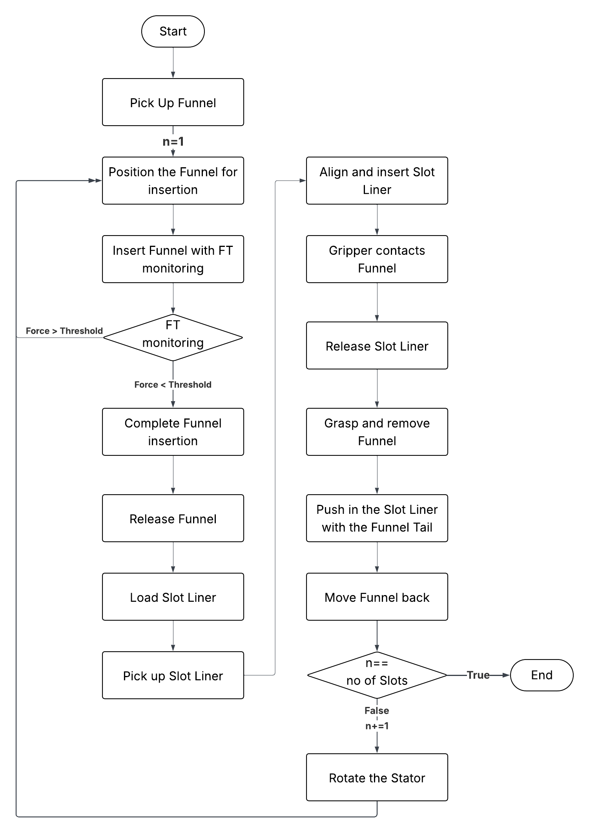
Insertion Pipeline

Slide 19
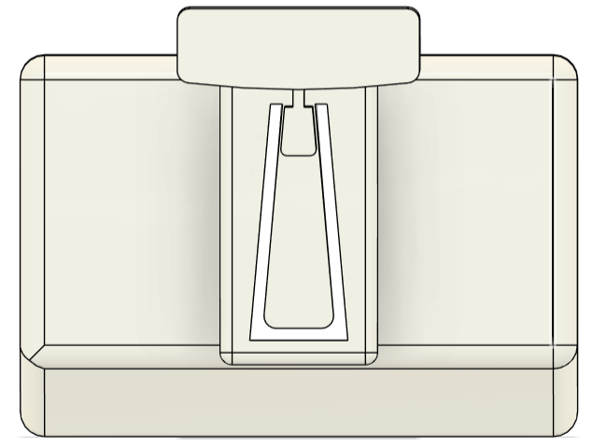
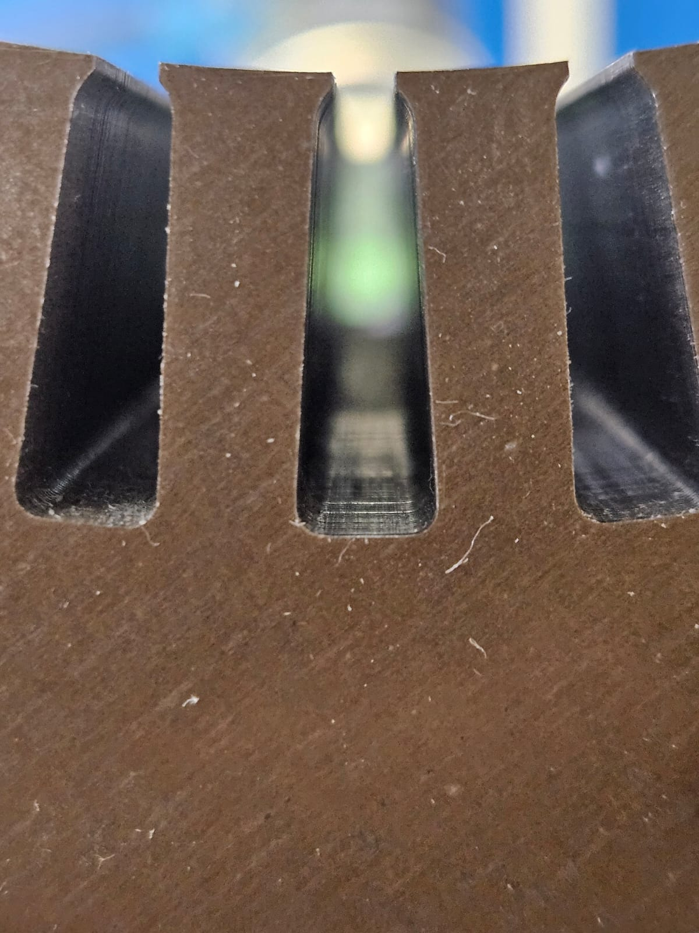
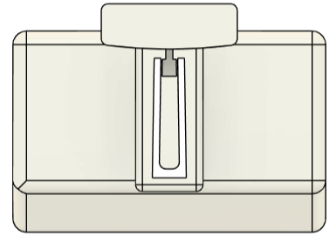
Validation
Slot Height – 20 mm
Slot Width – 8 mm
Slot angle – 85 deg
Slot Height – 19.8 mm
Slot Width – 8 mm
Slot angle – 85 deg
Stator A
Funnel A
Slot Height – 22 mm
Slot Width – 8 mm
Slot angle – 85 deg
Slot Height – 21.80 mm
Slot Width – 8 mm
Slot angle – 85 deg
Stator B
Funnel B
Slot Height – 18 mm
Slot Width – 5 mm
Slot angle – 89 deg
Slot Height – 17.80 mm
Slot Width – 5 mm
Slot angle – 89 deg
Stator C
Funnel C

Slide 20
Testing Results
260 insertion trials were conducted across three stators (A:100, B:100, C:60) to evaluate reliability and repeatability.
Preliminary trials for Stators A & B identified issues and refined parameters; Stator C tested directly with optimized settings.
Detailed records of defects and failure modes provided critical data for further system improvement.
The parametric insertion setup delivers consistent, repeatable, and robust liner placement, achieving a 97% success rate for Stators A and B, and 100% for Stator C

Slide 21
Error Rates
Stator A: 8 errors observed (6 pull-back with funnel, 2 misplacement on platform); improvements included standardized gripper handling, deeper insertion with inner finger, and stepwise funnel retraction, raising success rate from 80% to 97%.
Stator B: 10 errors observed (9 improper insertion, 1 funnel misalignment); improvements included controlled folding for consistent liner profiles and optimized funnel/gripper handling, increasing success rate from 77% to 97%.
Stator C: No errors observed in 60 trials; process performed flawlessly using optimizations from A & B, achieving 100% success even with the most constrained slot geometry.

Slide 22
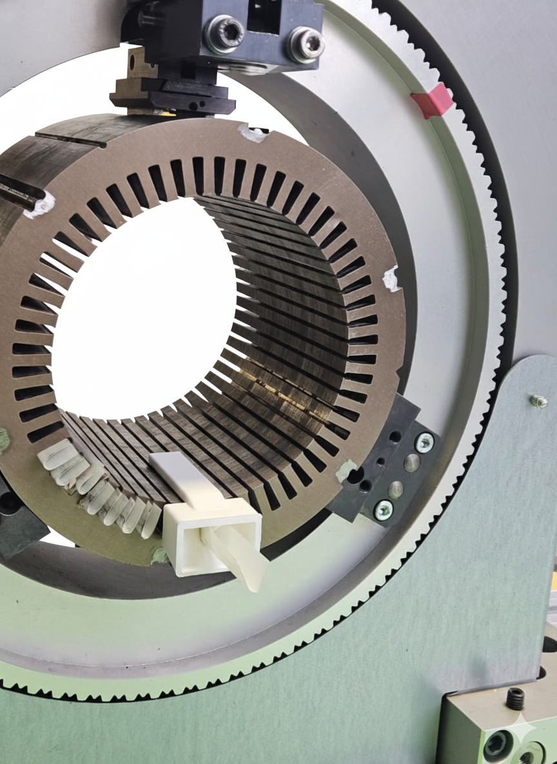
Result discussion
Success rates & cycle time: Optimized trials achieved 96.7% for Stators A & B and 100% for Stator C; average cycle time ~39.8 s, with room for improvement via motion optimization.
Process sensitivity: Performance depends heavily on slot liner geometry and consistency; small deviations can cause errors.
Current limitations: The process does not yet incorporate automated folding, creasing, or shaping of liners.
Potential improvements: Automating liner pre-processing and integrating pre-positioned dispensers can reduce variability, minimize robot travel, and improve cycle time
Industrial relevance: Adding vision-based quality assurance and adaptive feedback could enable a fully autonomous, scalable, flexible, and robust solution for stator assembly

Slide 23
Bibliography
[1] IEA (2025), Global electric car sales, 2014-2024, IEA, Paris
https://www.iea.org/data-and-statistics/charts/global-electric-car-sales-2014-2024, Licence: CC BY 4.0
[2] Xia, C.; Wang, H.; Wu, Y.; Wang, H. Joining of the Laminated Electrical Steels in Motor Manufacturing:
A Review. Materials 2020, 13, 4583. https://doi.org/10.3390/ma13204583
[3] A. Mahr, P. Mathea, A. Vogel, A. Morello, J. Franke, and A. Kühl, "Robotic based Assembly of insulating
Sleeves onto Winding Coil Ends of Electric Drive Stators," in 2023 13th International Electric Drives
Production Conference (EDPC), 2023, pp. 1–7.
[4} Nguyen, M. , Dario, S. , Malec, D. , Mary, D. , Cambronne, J. , Prunel, D. and Orgelet, J. (2017)
Environmental Assessment and Dielectric Performances of the Secondary Electrical Insulation in Low Voltage
Motors Impregnated by Different Techniques. Engineering, 9, 860-873. doi:10.4236/eng.2017.910051

Slide 25
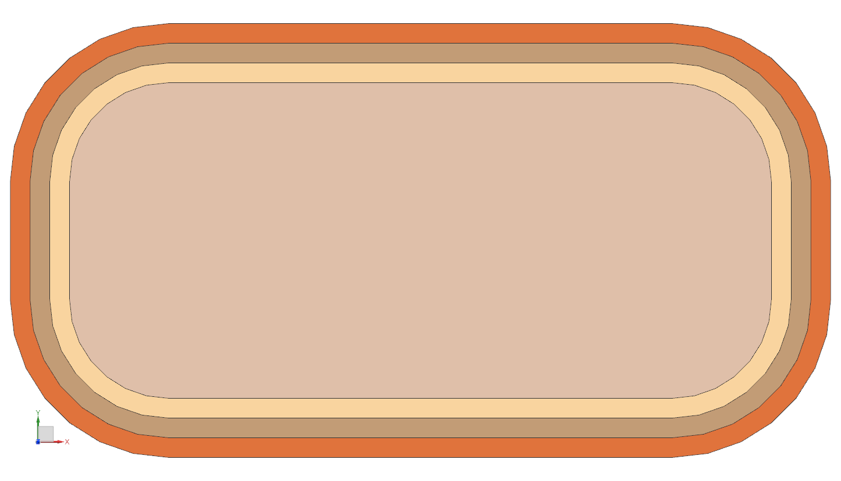
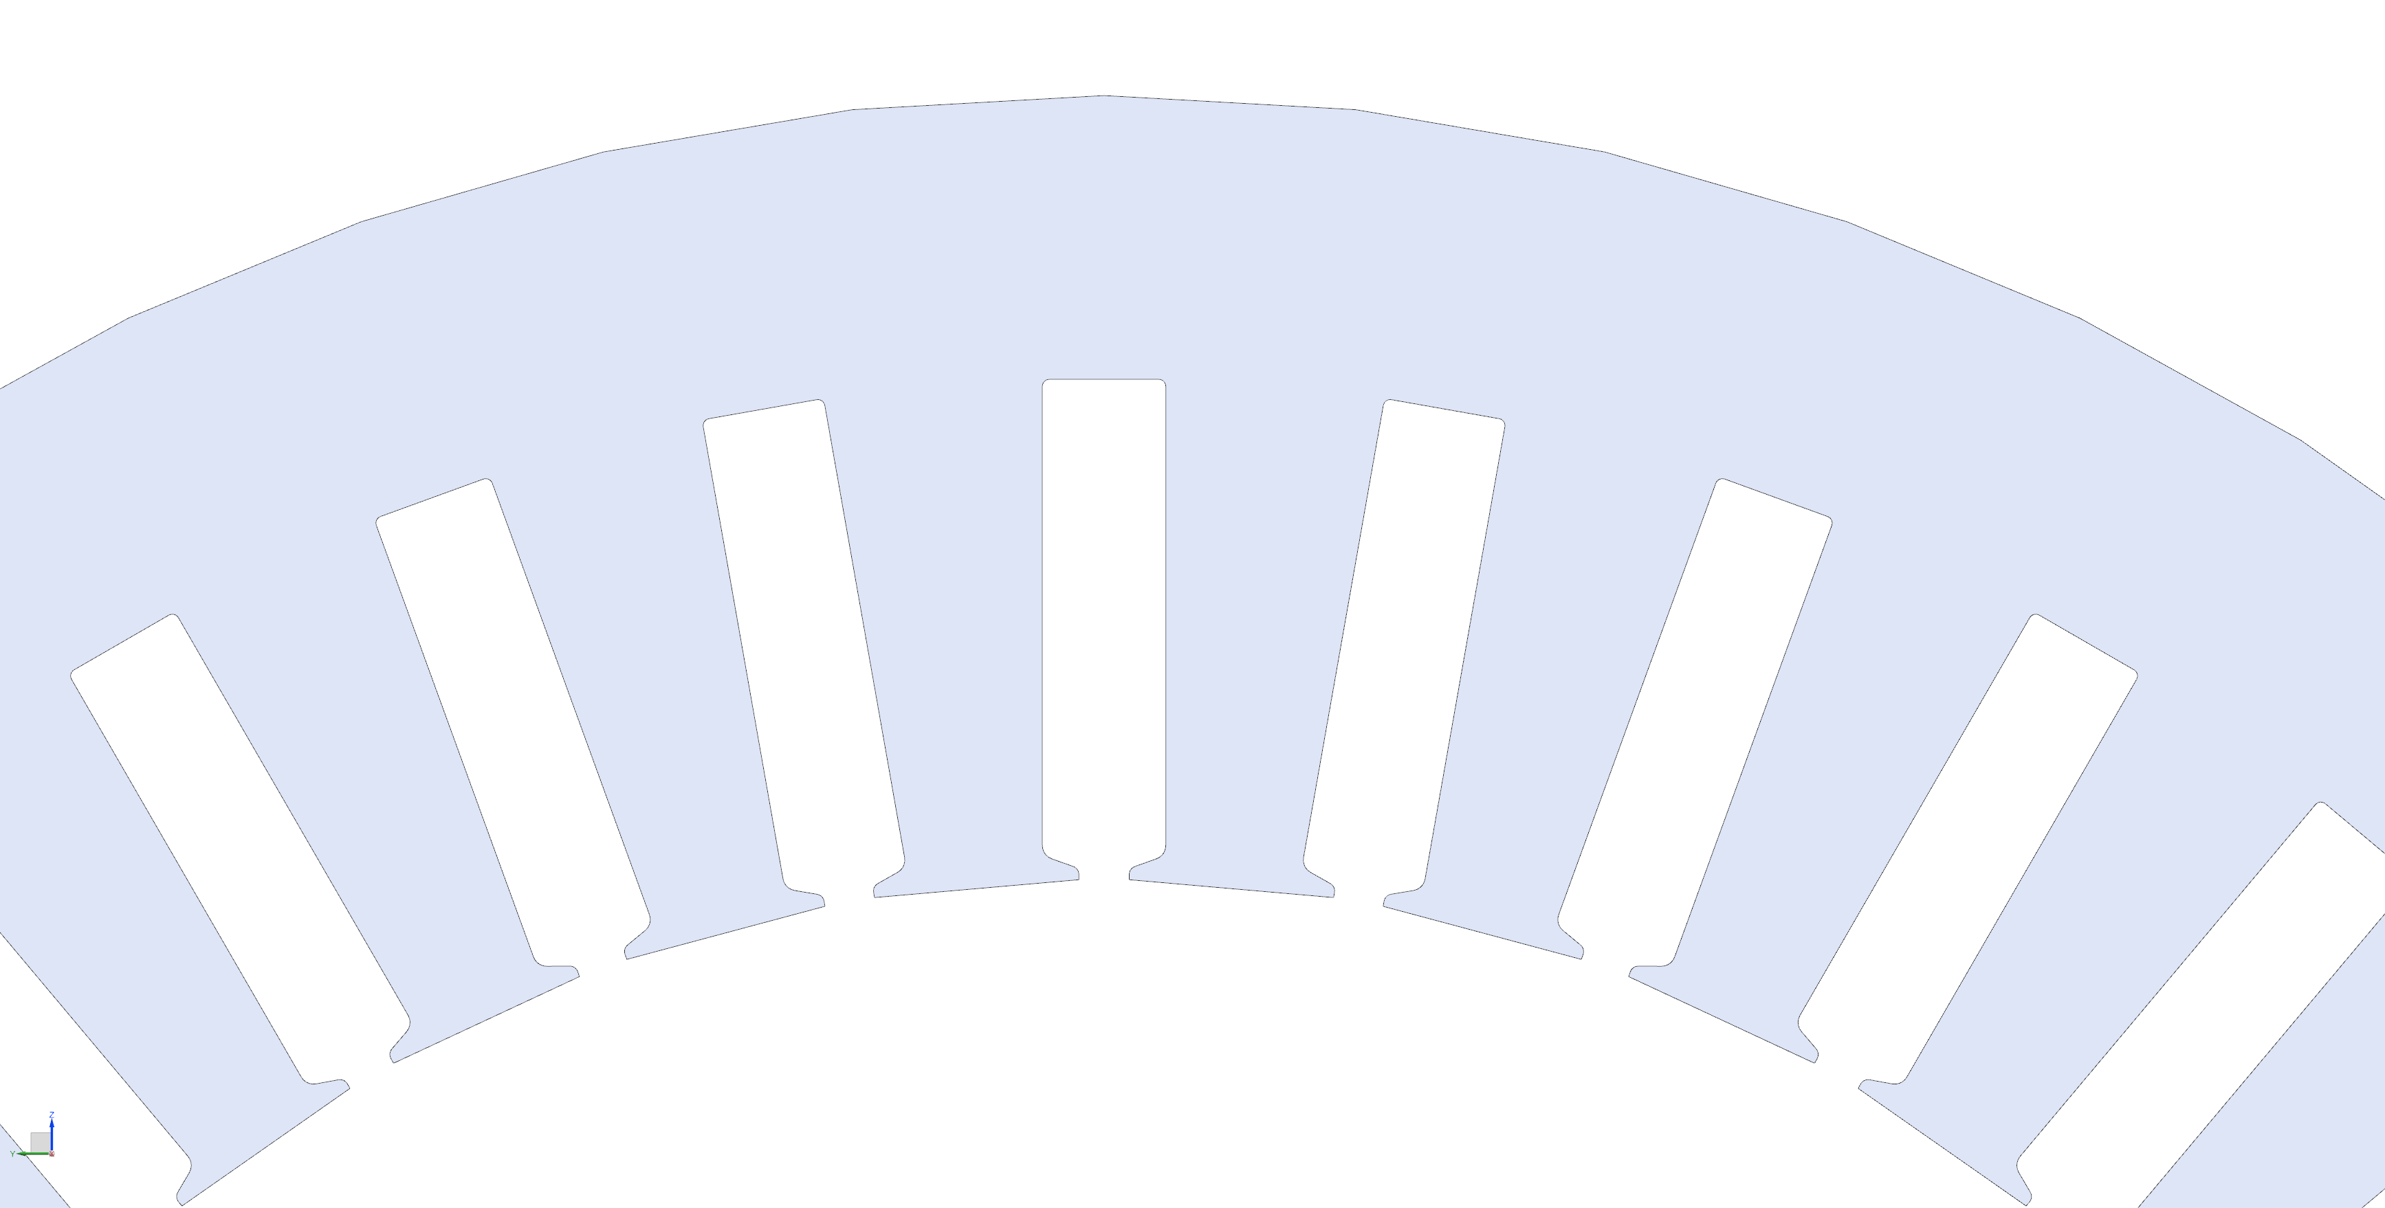

Linien etc
Trägermaterial (Kupfer)
4,4
4
1
1
1
5
2
3
Projektvergleich starten
Projektvergleich starten
D
$$I$$
16,3
wicklungstyp = 1
B
Leistungsteil Induktionsanlage
Anvil
1 A bei 50 Hz
Leitermaß
3,65
Außenmaß
1 A bei 50 Hz
Switch on/off control voltage
3,55
Gegenwerkzeug zur Fixierung und Ausrichtung der Einzelbleche
Kühleinheit Induktionsanlage
Anvil

